Slide 1
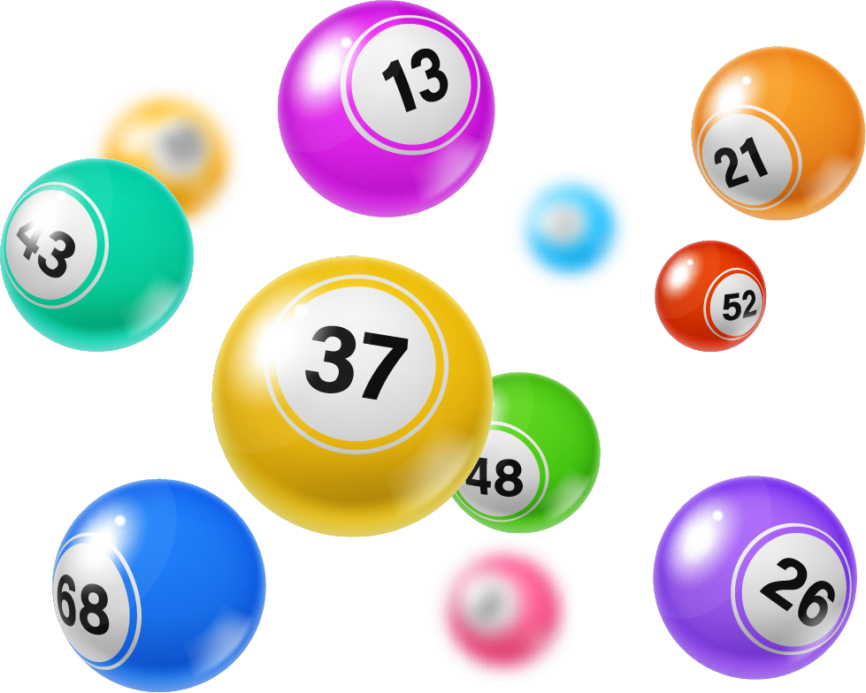
SHARE THE WINNINGS!

Slide 2
Introduction Two Parts: The Lottery Pool Affiliate Team Building

Slide 3
Founder Jeremy Duncan
Notes:
Jeremy Duncan – over 20 years experience in the network marketing space

Slide 4
Why did Jeremy create Share the winnings?
Alternative to the only other option of its kind
Simple with only one level of pay
Not crypto-based
Ability to use credit cards, cash app, direct bank transfer etc. if you like
Notes:
What we do…
Play the Mega Millions lottery twice per week.

Slide 5
Tuesday and Friday around 11PM Eastern
Monthly: 8-9 Chances of Winning!
You are sharing in a pool of potentially thousands of others
Notes:
What we do…
Play the Mega Millions lottery twice per week.

Slide 6
WANT IN?
Notes:
What we do…
Play the Mega Millions lottery twice per week.

Slide 7
FRIDAY IS THE WEEKLY CUT OFF
Make your payment by MIDNIGHT FRIDAY
To be eligible for the next week’s games.
Notes:
What we do…
Play the Mega Millions lottery twice per week.

Slide 8
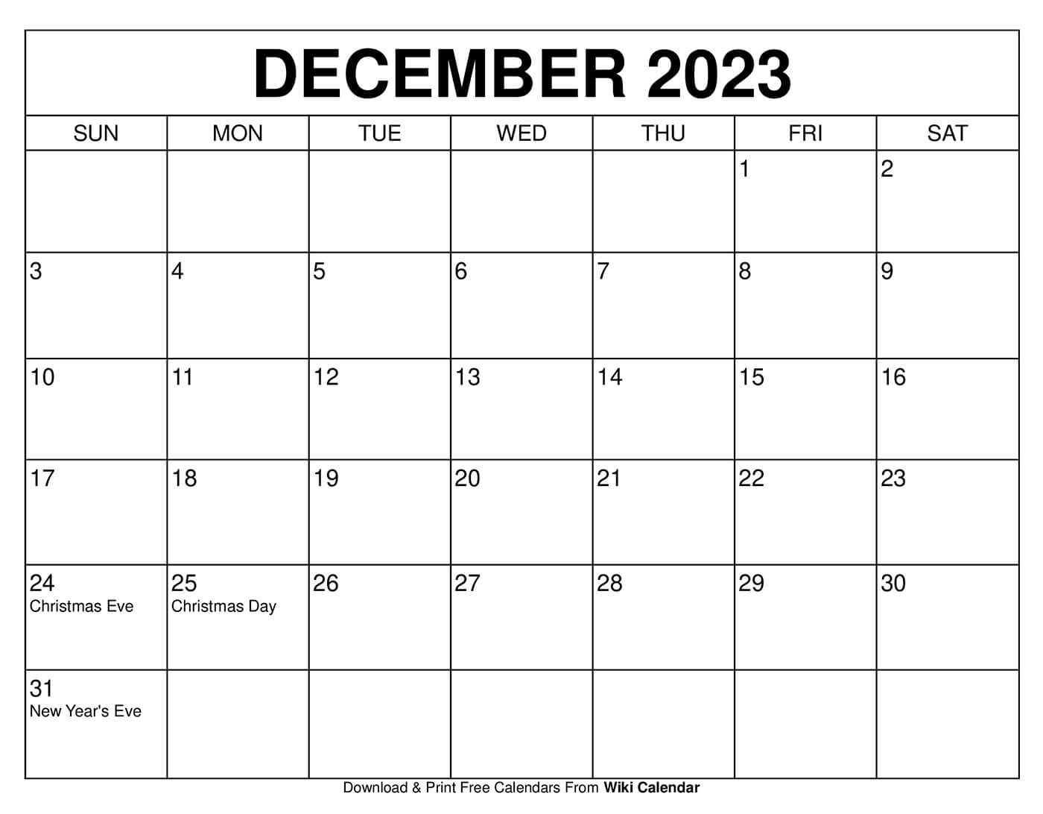
FRIDAY IS THE WEEKLY CUT OFF
Make your payment by 6PM FRIDAY
To be eligible for the next week’s games.
WEEKLY
CUTOFF
MIDNIGHT
PAY $60
FIRST
GAME
Notes:
What we do…
Play the Mega Millions lottery twice per week.

Slide 9
Affiliate Team Building
3x10 forced matrix
Notes:
What we do…
Play the Mega Millions lottery twice per week.

Slide 10
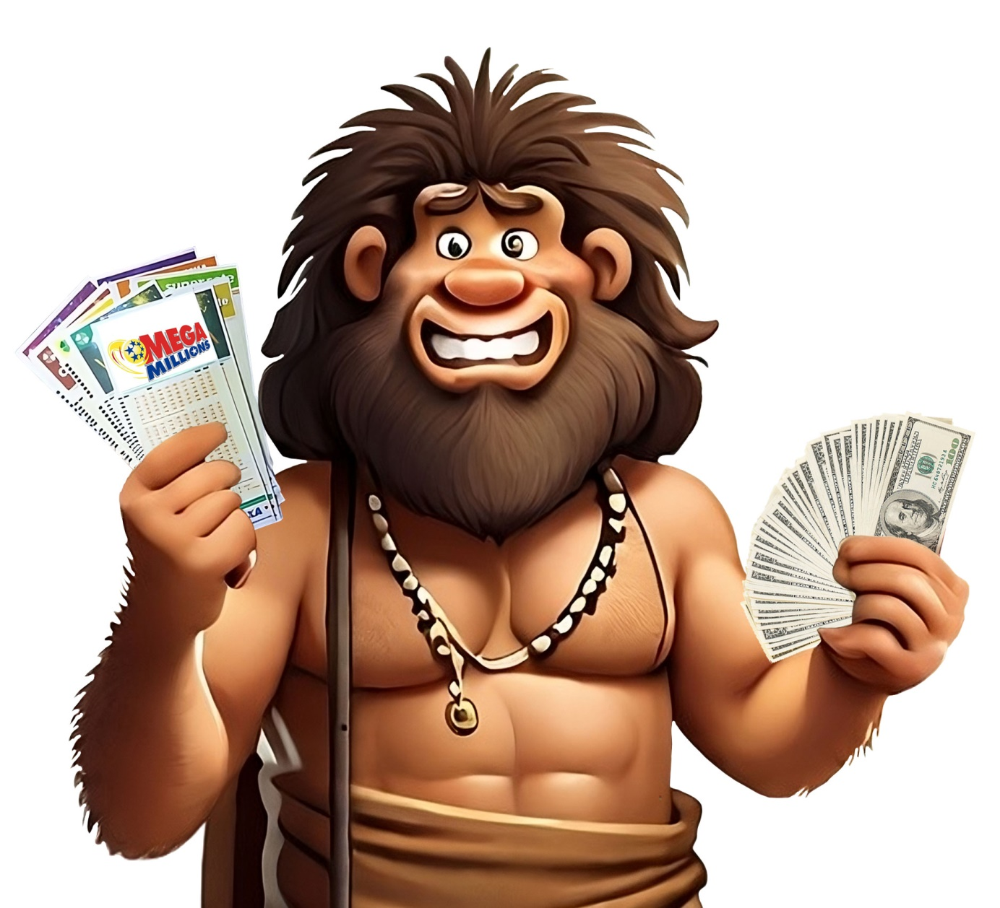
Caveman Simple 3X10 Comp Plan

Slide 11
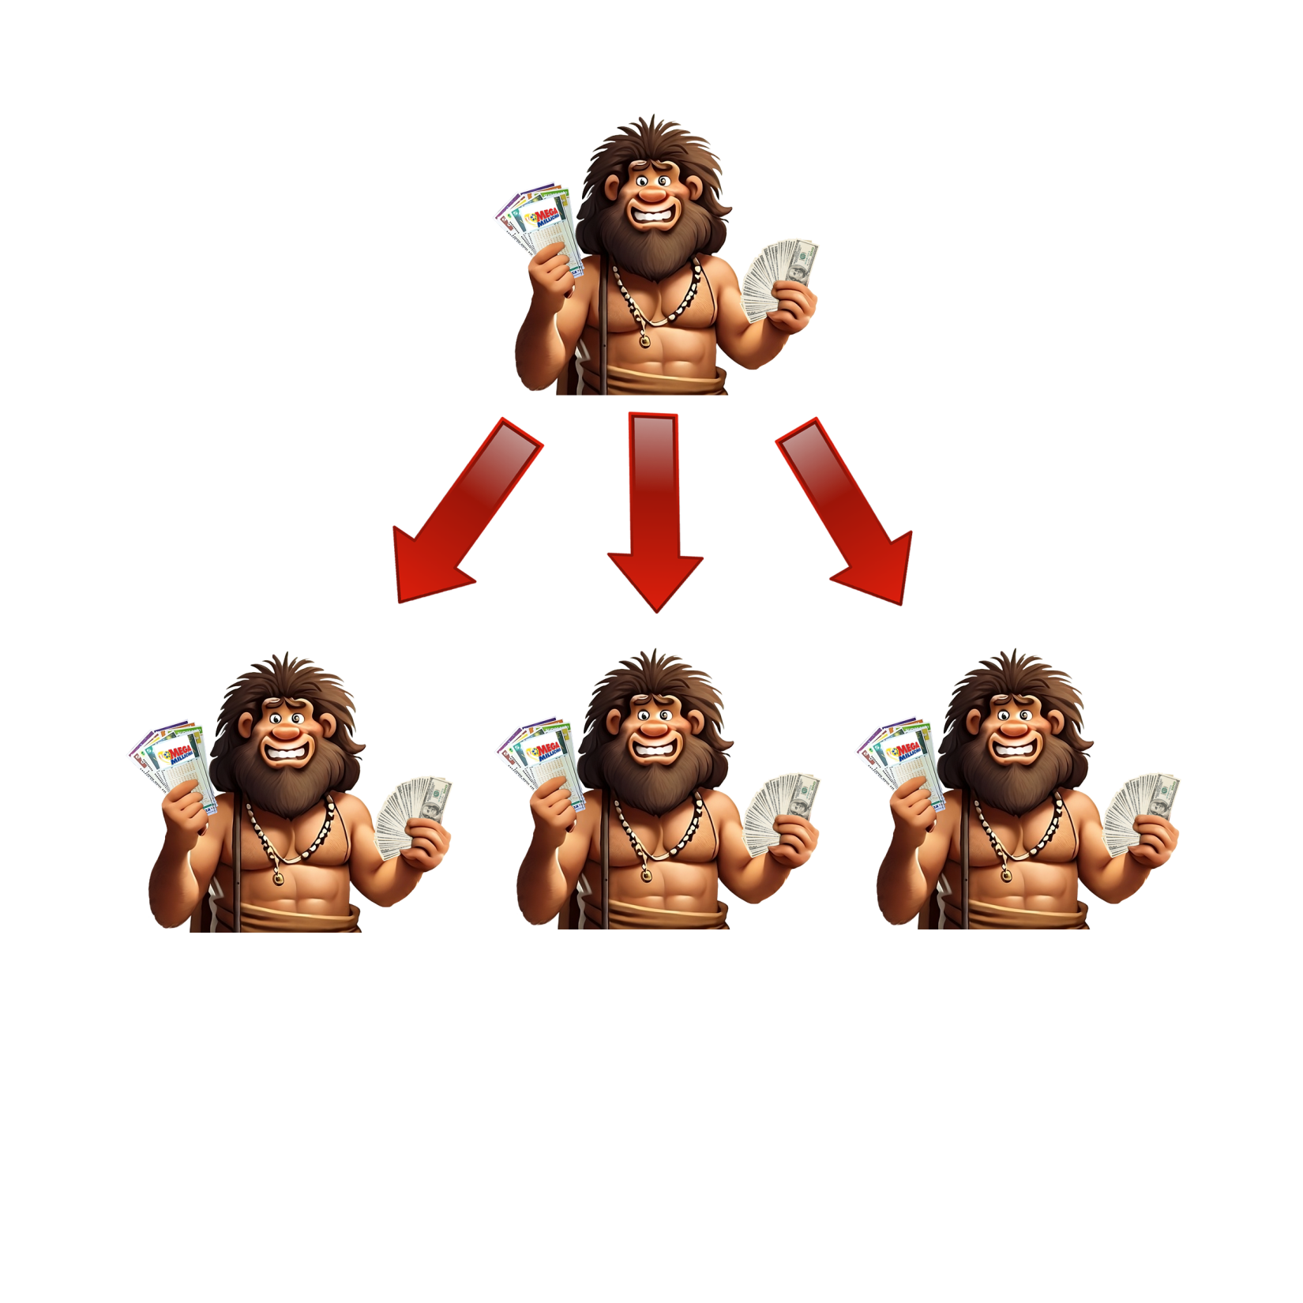
Matrix Fills Left to Right, Top to Bottom

Slide 12
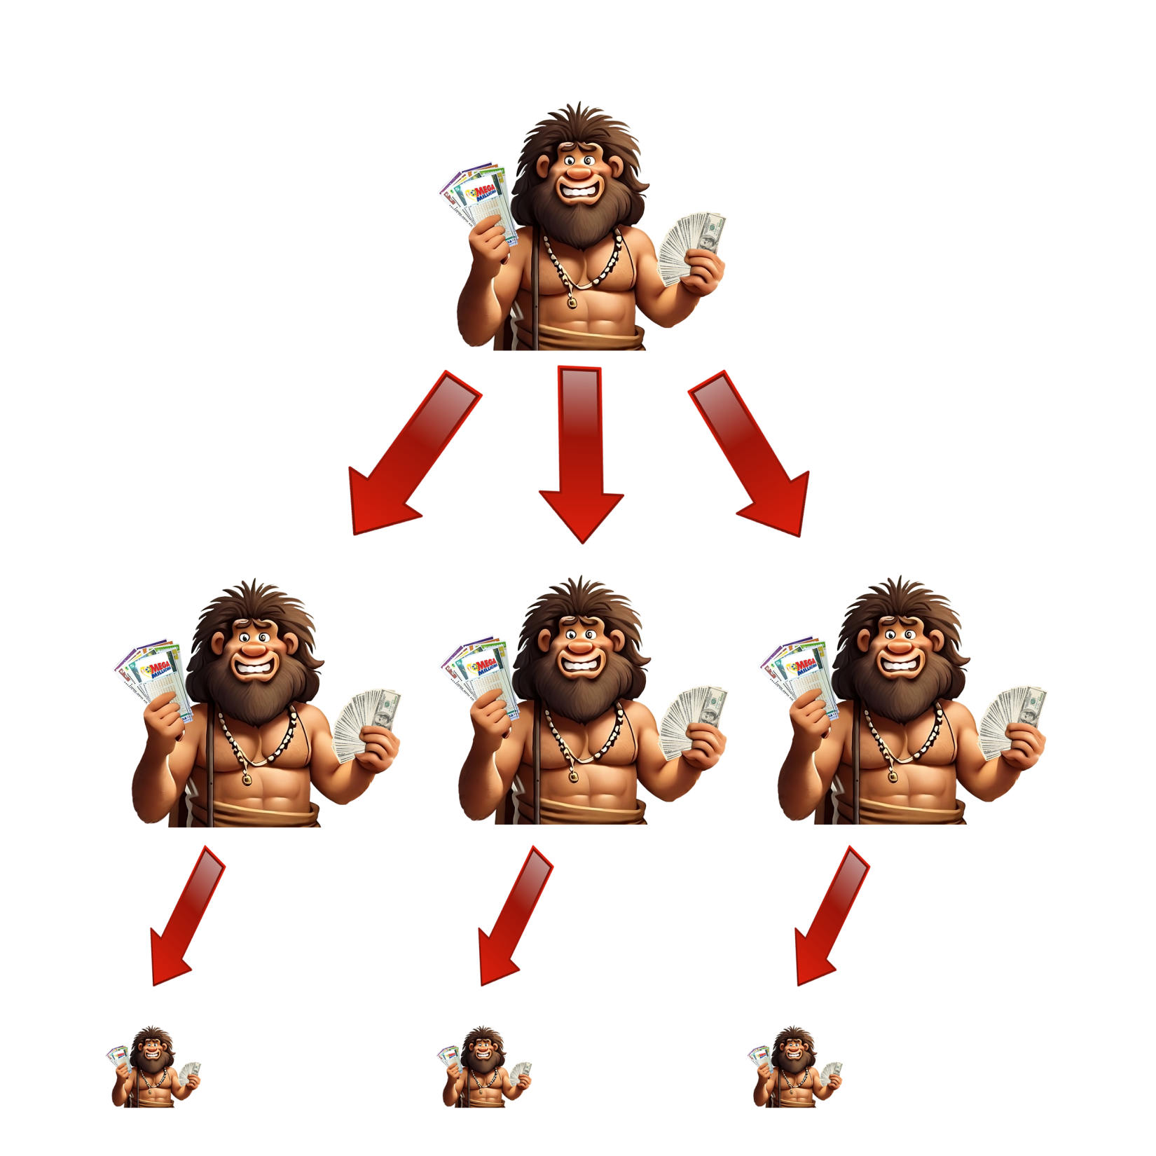

Slide 13
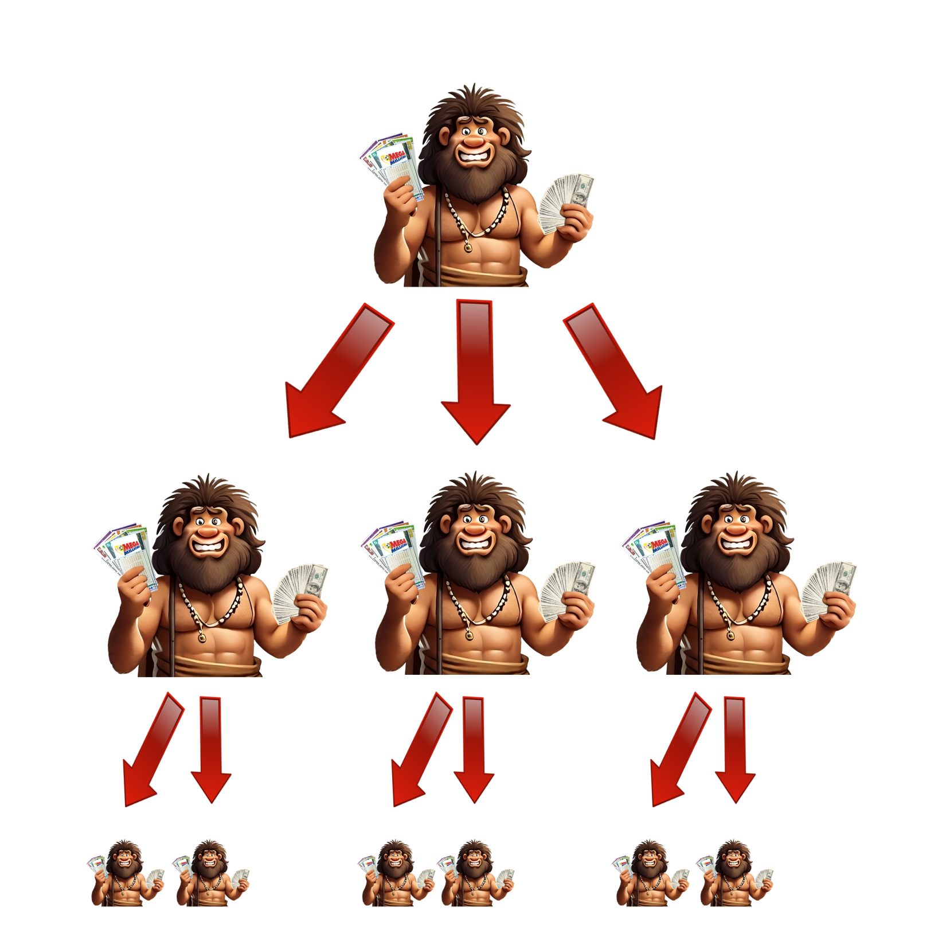

Slide 14
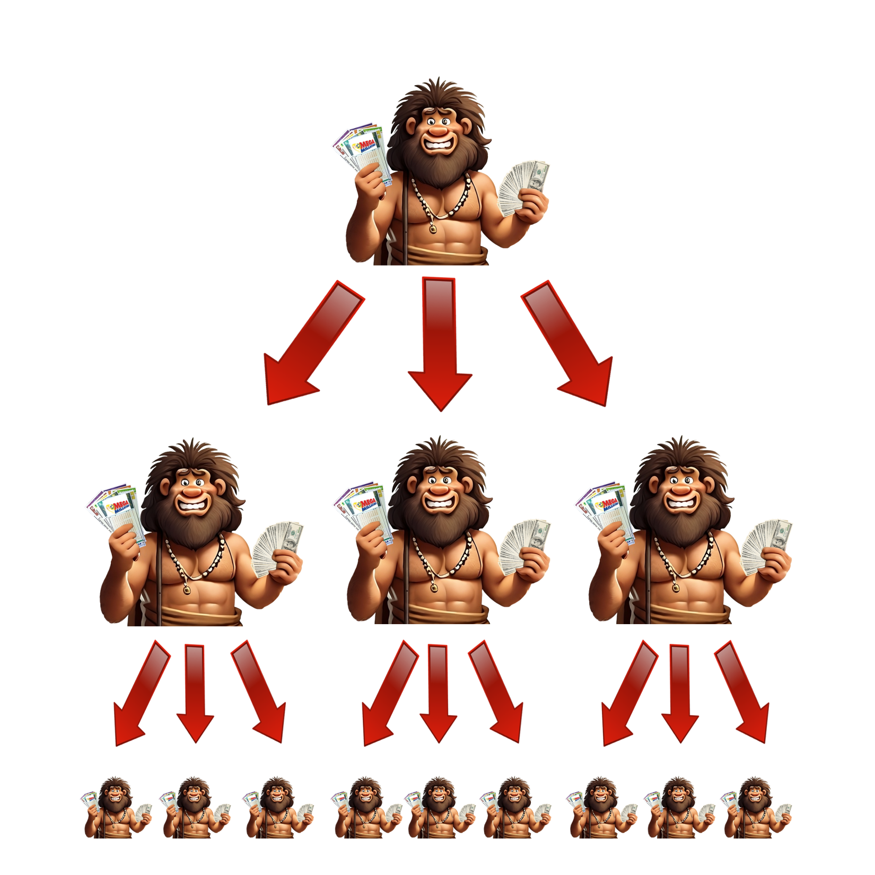

Slide 15
$20 Mo. Per Personal Referral
Sponsor 3 & You Are FREE!
.60 Cents Mo. Per Spill Over Member
No Sponsoring
Required

Slide 16
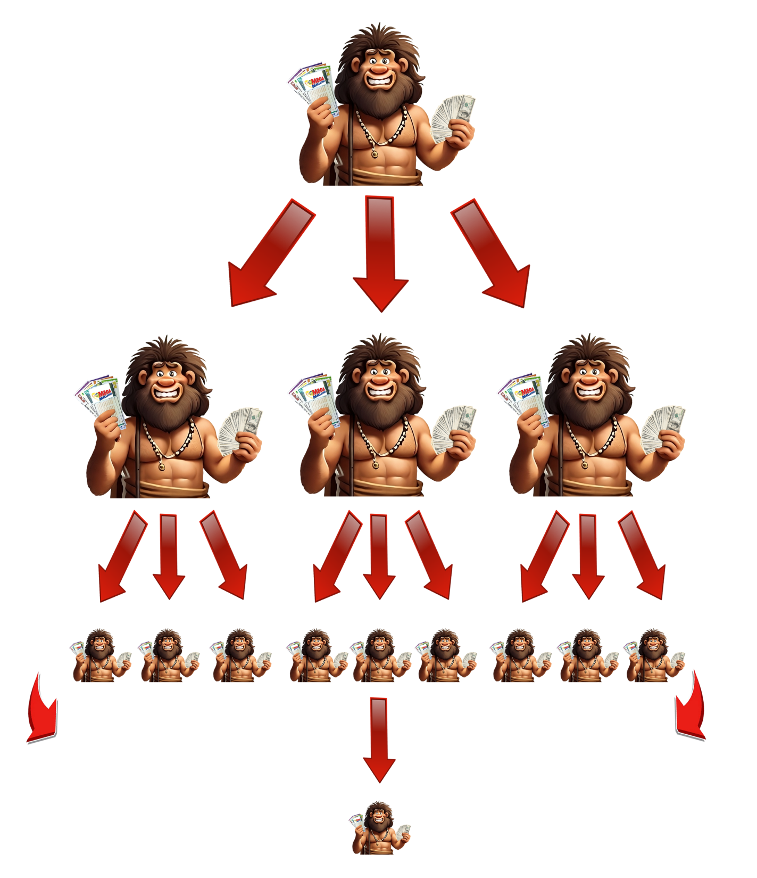

Slide 17
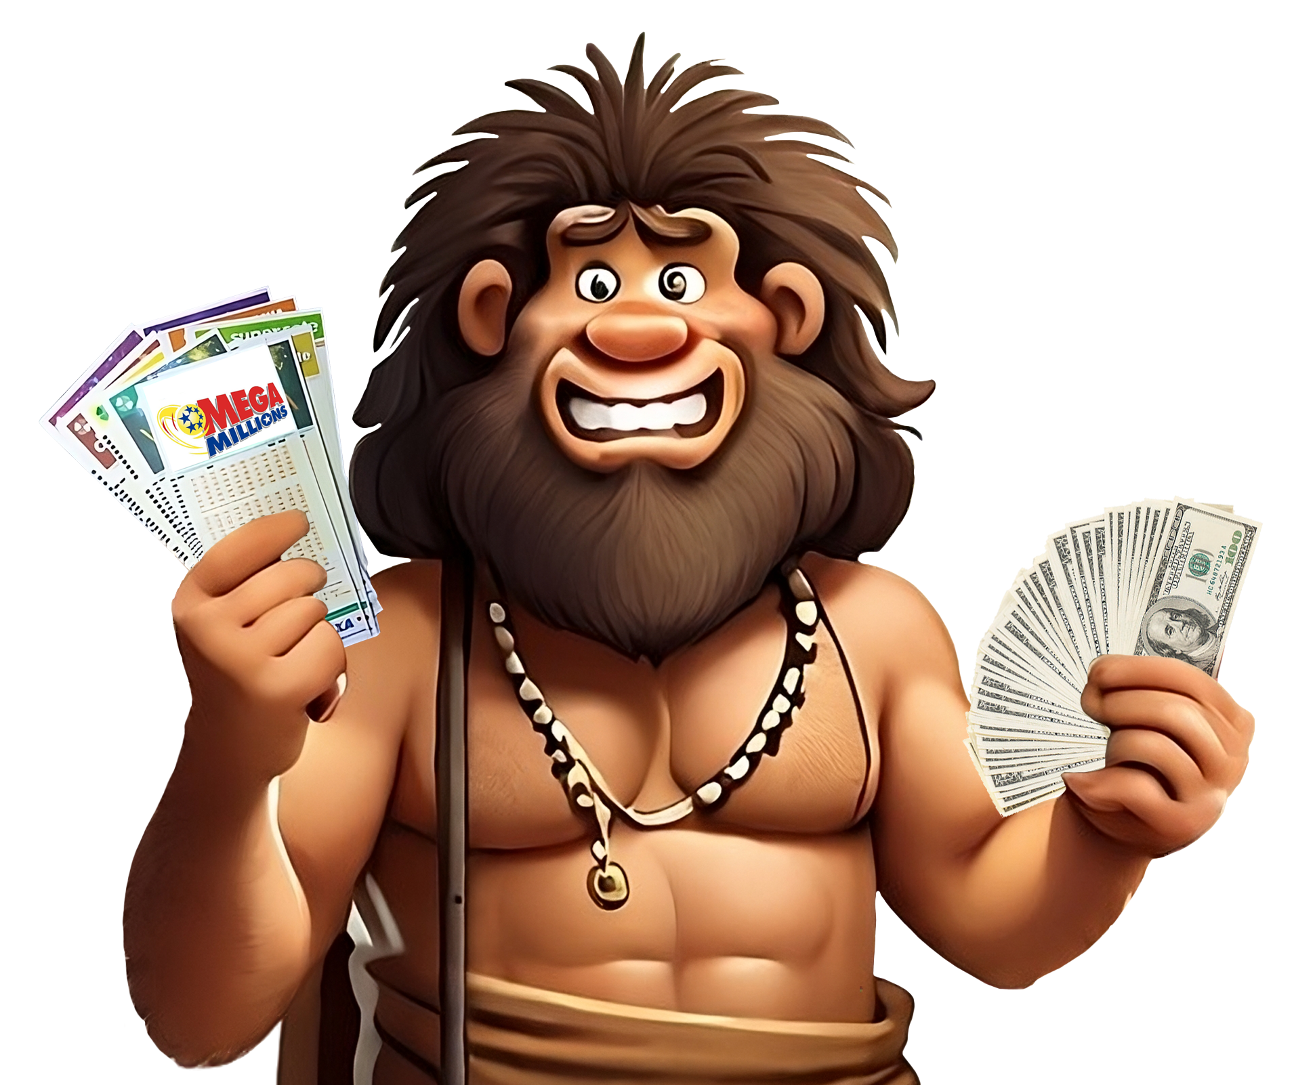
Compensation Benefits of STW!

Slide 18
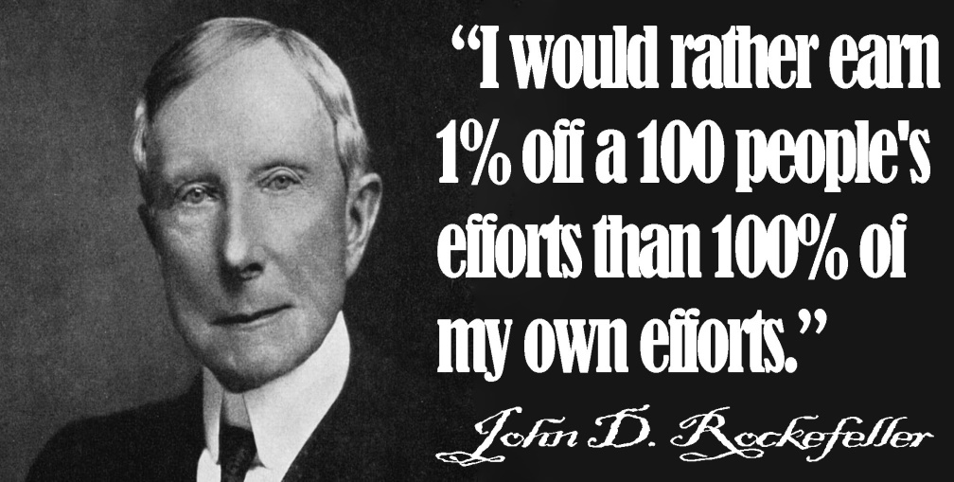
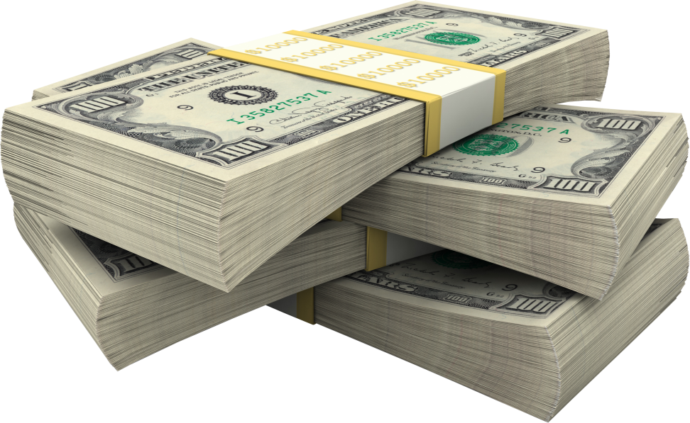
Compensation Benefits of STW!
5% Check Matching Bonus
Sponsor 3 & You Are Free!
$20 Mo. Per Personal Referral
No Sponsoring Required to Earn
We Buy Your Lotto Tickets Twice Weekly
Split All Winnings 10% @ 10 Levels
See Your Teammates Lotto Numbers
Totally Automated System For You
Play On Hundreds or Thousands of Tickets
8 to 10 Lottery Drawings Per Month

Slide 19
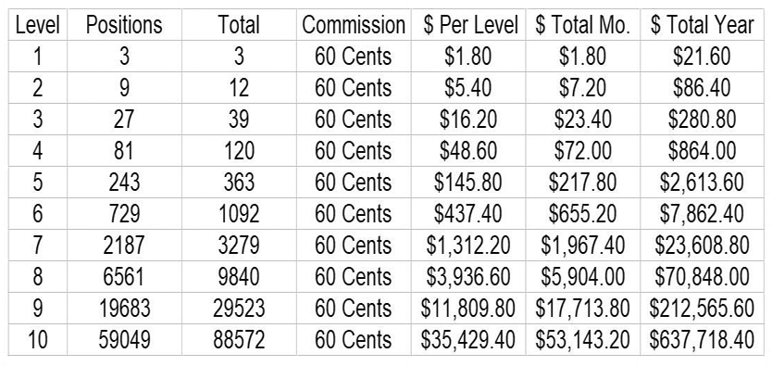
Compensation Pay Out

Slide 20
Affiliate Team Building
Affiliate Marketing Tools:
Banners
Text Ads
… MORE!
Notes:
What we do…
Play the Mega Millions lottery twice per week.

Slide 21
Marketing Minute
LOTTOTOOLS.NET
Notes:
What we do…
Play the Mega Millions lottery twice per week.

Slide 22
J.O.B.
Notes:
What we do…
Play the Mega Millions lottery twice per week.

Slide 23
Affiliate Team Building
$20/monthly fast start and
Earn Every Month!
Notes:
What we do…
Play the Mega Millions lottery twice per week.

Slide 24
Affiliate Team Building
“3 & yours is free”
Notes:
What we do…
Play the Mega Millions lottery twice per week.

Slide 25
Affiliate Team Building
Earn down TEN levels
Notes:
What we do…
Play the Mega Millions lottery twice per week.

Slide 26
Affiliate Team Building
Win 10% of your down line’s ticket winnings!
Notes:
What we do…
Play the Mega Millions lottery twice per week.

Slide 27
Affiliate Team Building
GET PAID DAILY
Notes:
What we do…
Play the Mega Millions lottery twice per week.

Slide 28
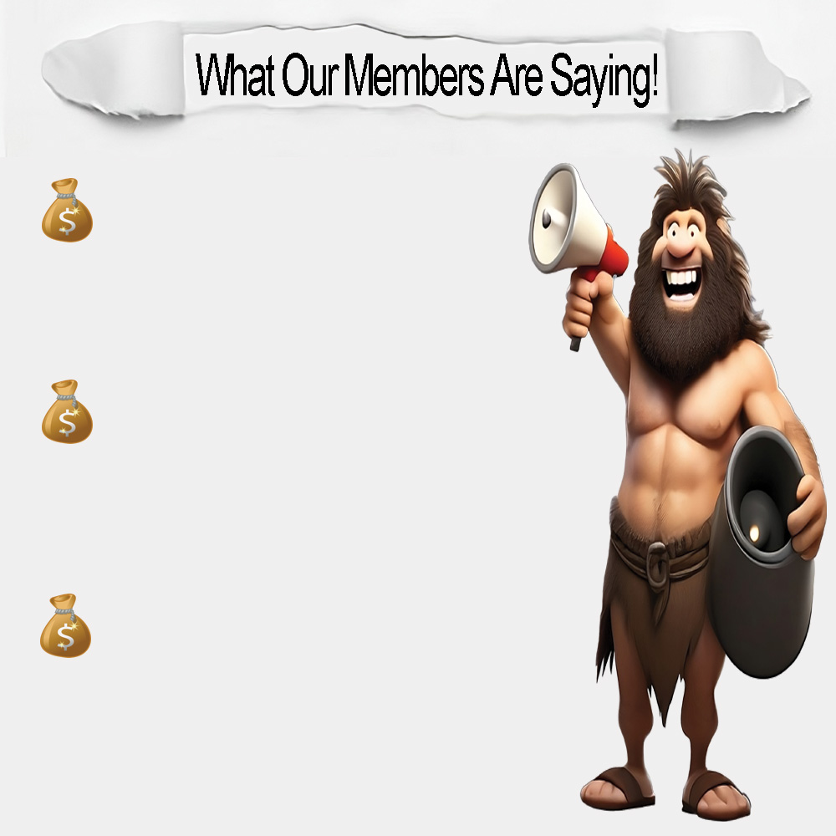
Tyrone from Fortville, IN
I Am Excited About STW Because It’s Just Like Playing With A Pool Of People, But You Are Guaranteed 10% Of The Winnings.
Wes From Tacoma, WA
STW Gives Everyone The Opportunity To Participate In The MegaMillions Lotto For Free (Get Your 3) And Increase Your Chances Of Splitting Winnings As A Team.
Ralph From Petersburg, VA
Increasing Chances And Maximizing Efforts Creates A Win Win For All Of Us Like Minded Members. Playing The MegaMillions Lottery Just Got Hundreds Of Times More Exciting.

